Slide 1
What is pollution?

Slide 2
Pollution
Pollution, also called environmental pollution, the addition of any substance (solid, liquid, or gas) or any form of energy (such as heat, sound, or radioactivity) to the environment at a rate faster than it can be dispersed, diluted, decomposed, recycled, or stored in some harmless form. The major kinds of pollution, usually classified by environment, are air pollution, water pollution, and land pollution. Modern society is also concerned about specific types of pollutants, such as noise pollution, light pollution, and plastic pollution. Pollution of all kinds can have negative effects on the environment and wildlife and often impacts human health and well-being.
https://www.britannica.com/science/pollution-environment

Slide 3
Classifications of Chemical Pollution
?
?
?

Slide 4
How does life work?

Slide 5
Requirements for Growth and Reproduction
Energy
Material
  Trace minerals and nutrients
  Major building blocks
Adequate genetics
Homeostasis
  Within organism
  Ecosystem
Disease prevention
  Noninfectious
  Infectious

Slide 6
Human Needs
  Vitamins
    A
    Bp, B1, B2, B3, B5, B6, B7, B9, B12
    C
    D
    E
    K
  Protein
    Histidine
    Isoleucine
    Leucine
    Lysine
    Methionine (and/or cysteine)
    Phenylalanine (and/or tyrosine)
    Threonine
    Tryptophan
    Valine
Calories
  Lipids
  Proteins
  Carbohydrates
Lipids
  linoleic acid
  linolenic acid
  arachidonic acid
Minerals
  Potassium
  Chloride
  Sodium
  Calcium
  Phosphorous
  Copper
  Iron
  Iodine
  Zinc
  Magnesium
  Manganese
  Molybdenum
  Selenium
Water
Oxygen
Sunlight?

Slide 7
What limits growth?

Slide 8
Liebig’s Law of the Minimum
Growth rates or yields are limited by the single growth factor that is:
in the shortest supply relative to its need

Slide 9
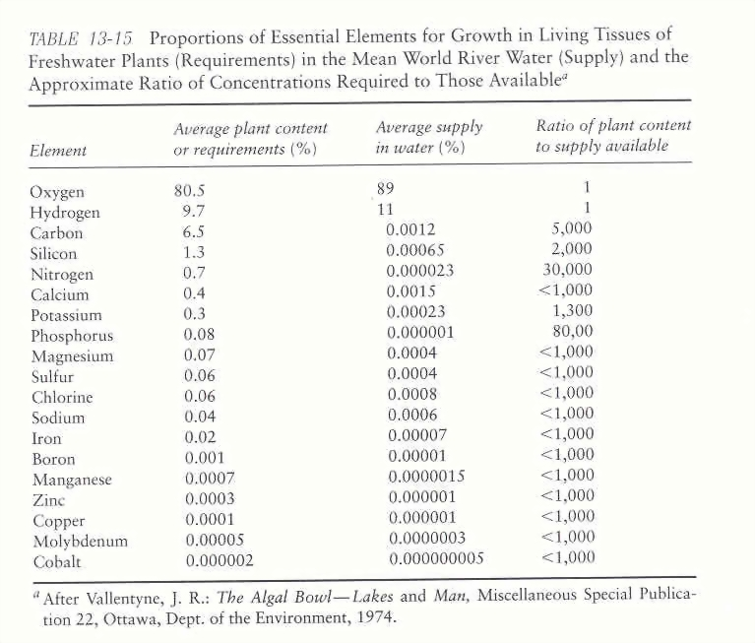
What is needed for growth?
0

Slide 10
Eutrophication
What is it?
Is it a “natural” process
What is the big deal?

Slide 11
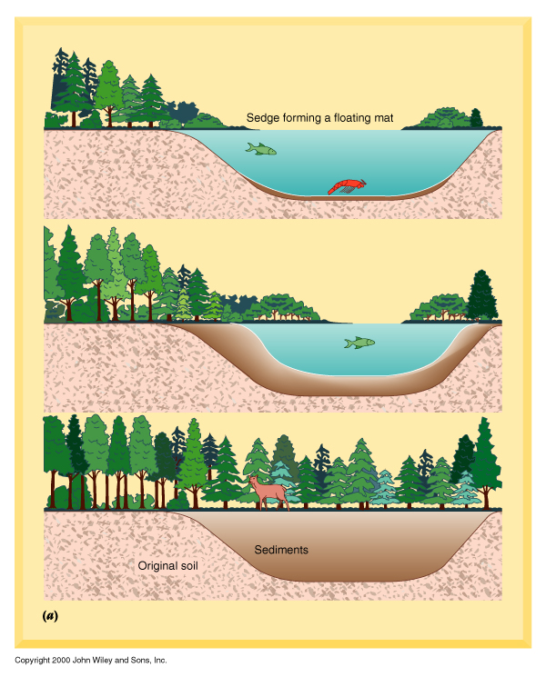
Eutrophication
Natural Process
  Succession
Cultural Eutrophication
  Where do nutrients come
  from?

Slide 12
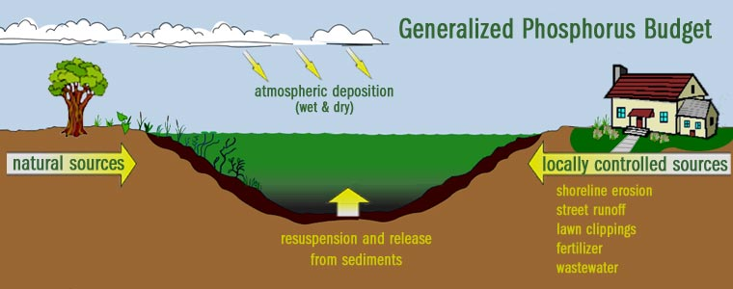

Slide 13
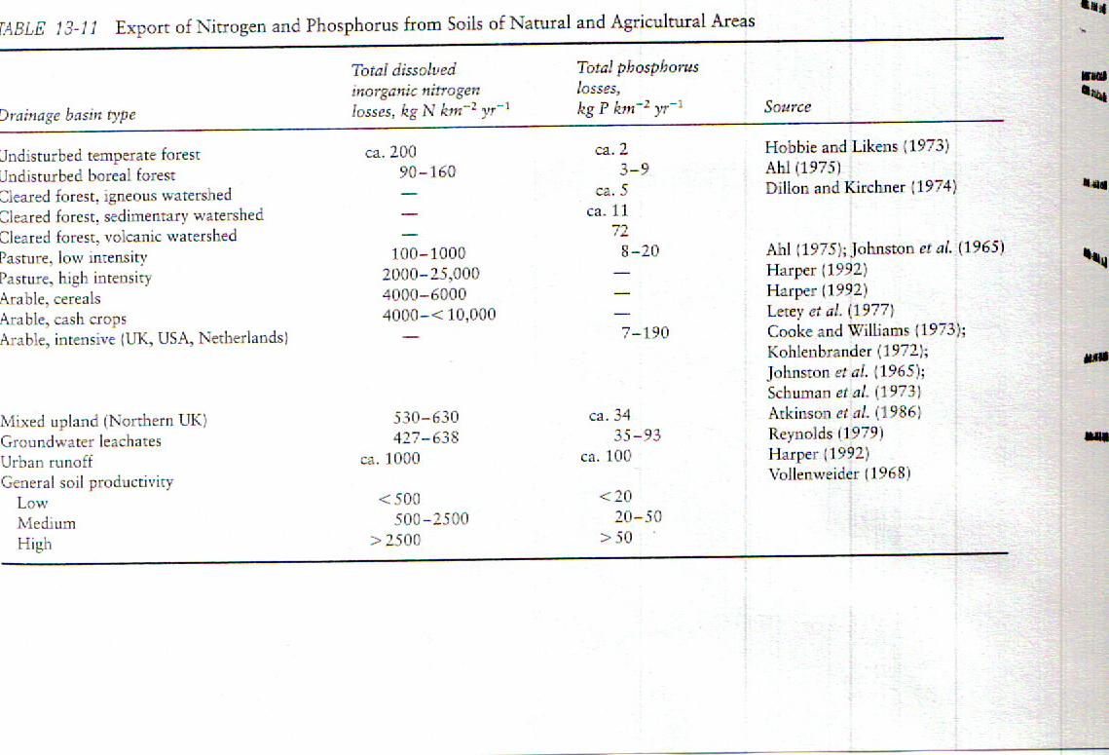

Slide 14
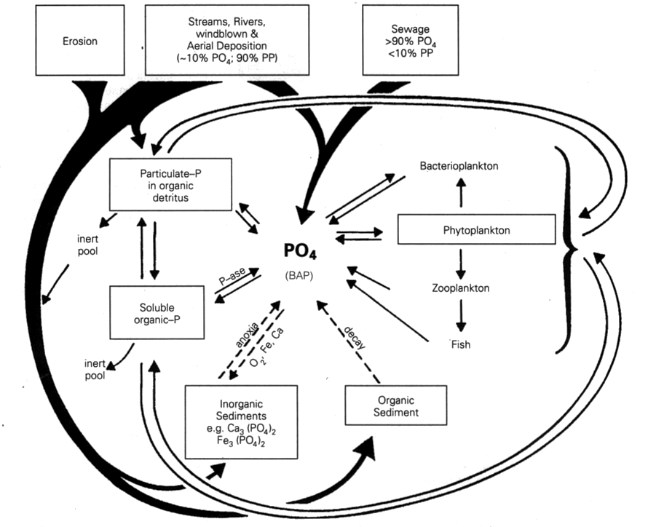
=Cultural Eutrophication

Slide 15
Lake Productivity Classification | Total Phosphorus ug/L
Ultra-oligotrophic | <5
Oligotrophic | 5-10
Mesotrophic | 10-30
Eutrophic | 30-100
Hypereutrophic | >100

Slide 16
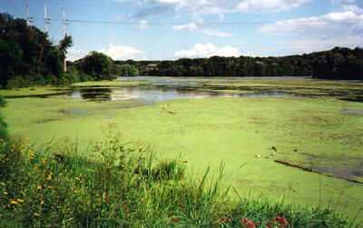
What’s the Big Deal?

Slide 17
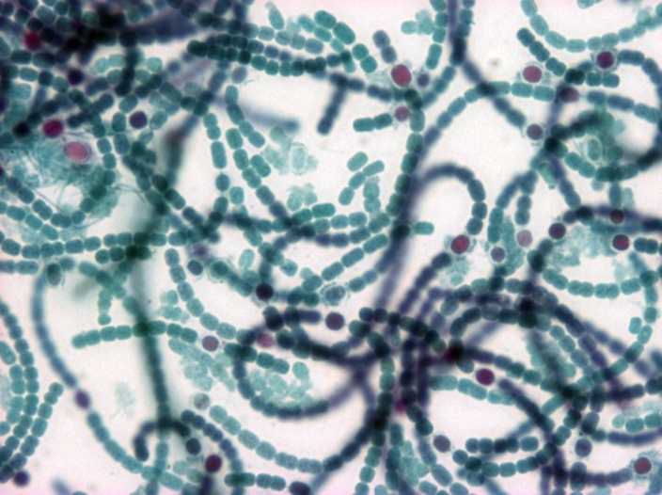
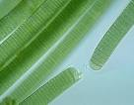
What’s the Big Deal?
Taste and Odor (T&O) Compounds
Producers
  Cyanobacteria (Anabaena sp., Microcystis sp., Oscillatoria sp.)
Organic compounds
  Geosmin – “earth smell”
  MIB (2-methylisoborneol)
Low human detection limits
  >5-10 parts per trillion (ng/L)
No known effects on human health

Slide 18
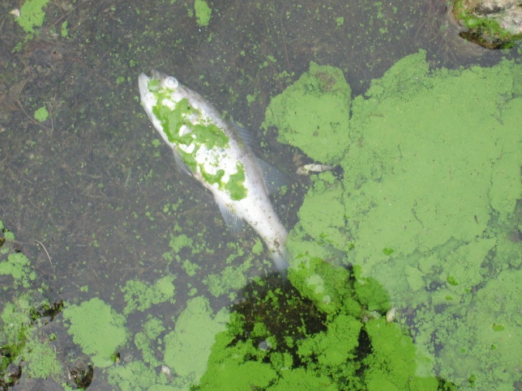
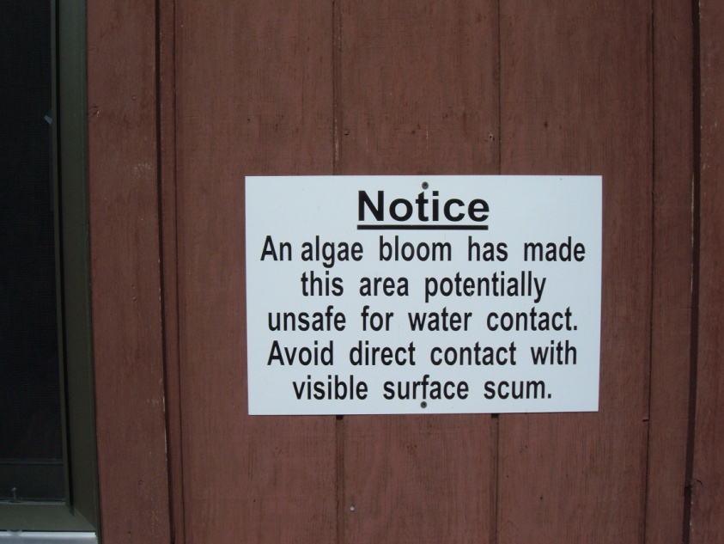
What’s the Big Deal?
Algal Toxins
Cyanotoxins
Producers
  Microcystins (Anabaena, Microcystis, Oscillatoria)
    Fish/dog kills
    Human health?

Slide 19
What’s the Big Deal?
General Water Quality
Dissolved oxygen
Notes:
…

Slide 20
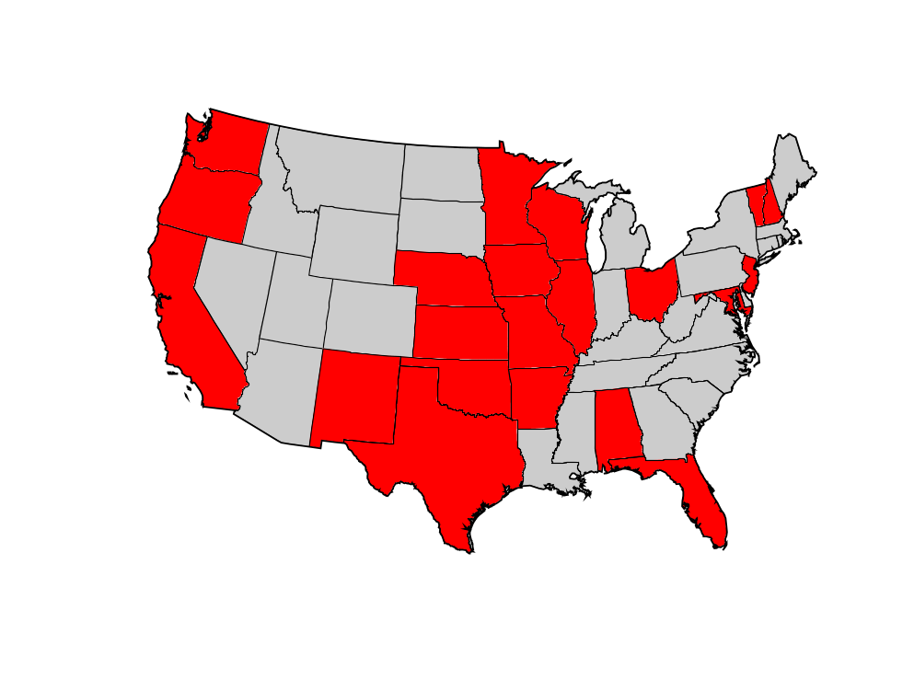
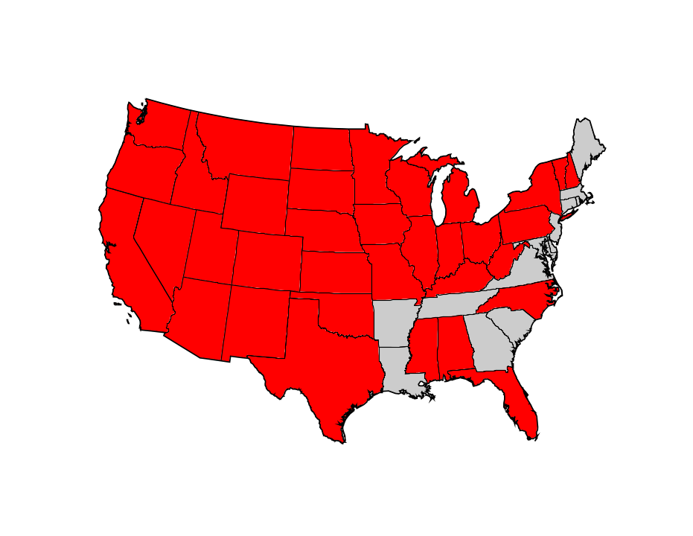
Cyanobacterial Blooms are a common problem in the United States…
Cyanobacteria Made the News in at Least 21 U.S. States During 2006
At Least 35 U.S. States With Reports
of Cyanotoxin Associated Poisonings

Slide 21
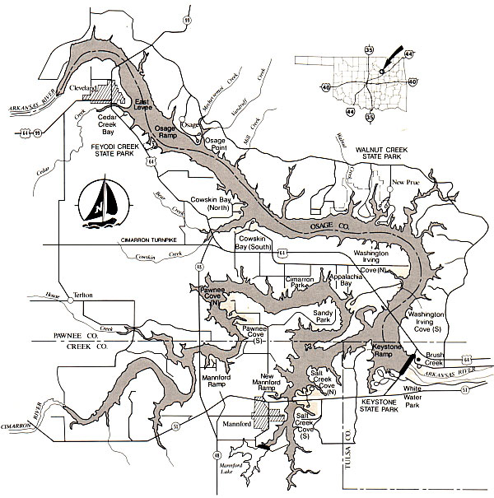
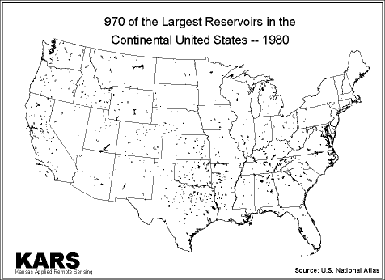
How about in Oklahoma?
Reservoirs vs natural lakes
Most reservoirs in the state are eutrophic or hypereutrophic

Slide 22
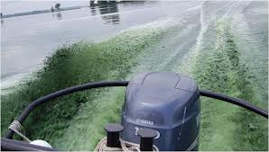
Grand Lake
2011 was a bad year…
National attention
Increased awareness

Slide 23
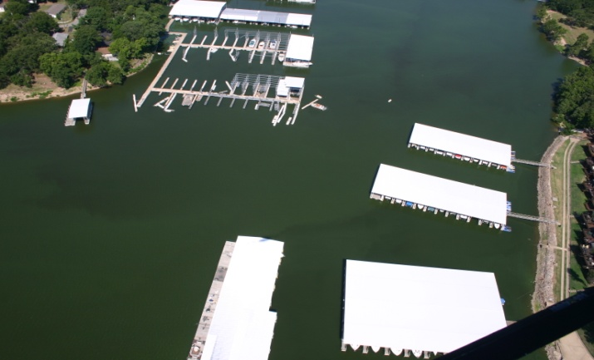
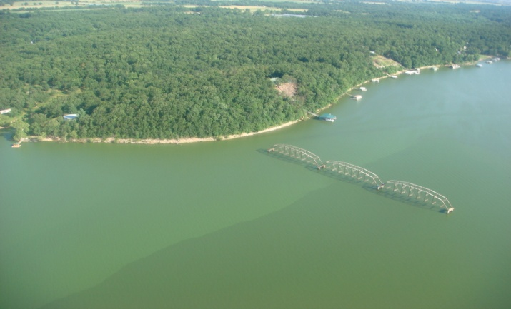
Blue-green algae bloom on Grand Lake in July, 2011: (Left) Duck Creek arm near popular commercial marinas and (Right) Unfinished bridge located in the Horse Creek arm.

Slide 24
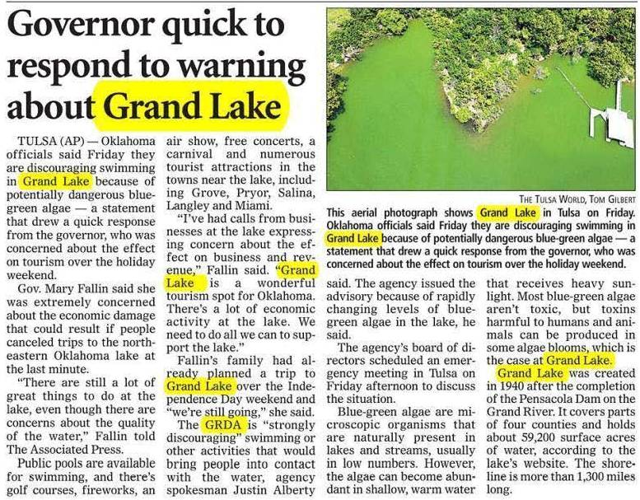
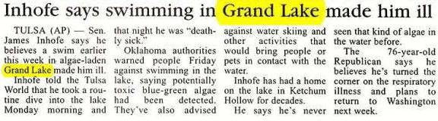
Lawton Constitution: July 2, 2011
Durant Daily Democrat: July 3, 2011

Slide 25
FAQs
The Grand River Dam Authority on Friday strongly cautioned people to stay out of Grand Lake because of blooms of potentially dangerous blue-green algae, which can cause intestinal and respiratory problems in humans and animals if ingested in large enough amounts. The following are some questions and answers about the situation:
What is blue-green algae?
A free-floating microscopic organism that is naturally present in lakes but usually found in low numbers. It is actually cyanobacteria. It is dangerous because of its ability to produce and release toxins in the water.
When will it be safe to go back in the lake?
Officials said Friday it’s unclear when it will be safe. Algae blooms can persist for weeks or even months.
How do I know whether I’ve been affected?
The toxins can cause stomach and intestinal illness, trouble breathing, allergic responses, skin irritation, tingling fingers or toes and, rarely, liver damage. Children are particularly susceptible.
If I’ve been in the lake in the last week or two, what should I do?
Symptoms cannot be prevented after contact, but those who develop severe symptoms should contact their physician. Some symptoms can develop within minutes, but others can take a week to appear.
What should I do if I come into contact with blue-green algae?
Wash with fresh water and soap after skin contact.
Should I eat fish caught in a lake with blue-green algae?
Although the danger of eating fish from water with the algae isn’t completely understood, health officials do not recommend it.
How did this happen?
The algae uses oxygen and photosynthesis to reproduce. It feeds on phosphorus and nitrogen that can come from lawn fertilizer, chicken litter or sewage treatment runoff. Officials said Friday the lake had elevated levels of phosphorus and nitrogen. The algae grows mostly in hot temperatures and still waters. Recent high temperatures helped fuel that growth.
Is there anything that can be done to get the algae out of the lake?
Nothing feasible. Until it expends its primary fuel sources — oxygen, nitrogen and phosophorous — it will continue to survive. Chemicals can kill the algae, but the amount of chemical needed would create a different set of environmental and health concerns.
What do blue-green algae look like?
It can have a green, bluish, brownish or reddish-green color and has the thickness of soup or paint. It can look like an oil slick. On the shore, it can form a thick mat
FAQs
The Grand River Dam Authority on Friday strongly cautioned people to stay out of Grand Lake because of blooms of potentially dangerous blue-green algae, which can cause intestinal and respiratory problems in humans and animals if ingested in large enough amounts. The following are some questions and answers about the situation:
What is blue-green algae?
A free-floating microscopic organism that is naturally present in lakes but usually found in low numbers. It is actually cyanobacteria. It is dangerous because of its ability to produce and release toxins in the water.
When will it be safe to go back in the lake?
Officials said Friday it’s unclear when it will be safe. Algae blooms can persist for weeks or even months.
How do I know whether I’ve been affected?
The toxins can cause stomach and intestinal illness, trouble breathing, allergic responses, skin irritation, tingling fingers or toes and, rarely, liver damage. Children are particularly susceptible.
If I’ve been in the lake in the last week or two, what should I do?
Symptoms cannot be prevented after contact, but those who develop severe symptoms should contact their physician. Some symptoms can develop within minutes, but others can take a week to appear.
What should I do if I come into contact with blue-green algae?
Wash with fresh water and soap after skin contact.
Should I eat fish caught in a lake with blue-green algae?
Although the danger of eating fish from water with the algae isn’t completely understood, health officials do not recommend it.
How did this happen?
The algae uses oxygen and photosynthesis to reproduce. It feeds on phosphorus and nitrogen that can come from lawn fertilizer, chicken litter or sewage treatment runoff. Officials said Friday the lake had elevated levels of phosphorus and nitrogen. The algae grows mostly in hot temperatures and still waters. Recent high temperatures helped fuel that growth.
Is there anything that can be done to get the algae out of the lake?
Nothing feasible. Until it expends its primary fuel sources — oxygen, nitrogen and phosophorous — it will continue to survive. Chemicals can kill the algae, but the amount of chemical needed would create a different set of environmental and health concerns.
What do blue-green algae look like?
It can have a green, bluish, brownish or reddish-green color and has the thickness of soup or paint. It can look like an oil slick. On the shore, it can form a thick mat

Slide 26
Oligotrophic vs. Eutrophic
Feature | Oligotrophic | Eutrophic
Nutrient Level
Phytoplankton Levels
Oxygen Levels (minimum)
Water clarity
Light Penetration

